Slide 1
DATABASE
File and Index Structure

Slide 2
Outline
Disks and Files
Indexes and Databases
Hash Files

Slide 3
Disks and Files
DBMS stores information on (“hard”) disks.
  A disk is a sequence of bytes, each has a disk address.
  READ: transfer data from disk to main memory (RAM).
  WRITE: transfer data from RAM to disk.
Data are stored and retrieved in units called disk blocks or pages.
  Each page has a fixed size, say 512 bytes. It contains a sequence of records.
  In many (not always) cases, records in a page have the same size, say 100 bytes.

Slide 4
Why Not Store Everything in Main Memory?
Costs too much. RAM is much more expensive than disk.
Main memory is volatile. We want data to be saved between runs.
Typical storage hierarchy:
  Main memory (RAM) for currently used data.
  Disk for the main database (secondary storage).
  Tapes for archiving older versions of the data (tertiary storage).

Slide 5
Components of a Disk
Block size is a multiple of sector size (which is fixed).
Spindle
Disk head
Tracks
Surface of platter divided into circular tracks
Each track is divided into sectors.
  A sector is the smallest unit of data that can be read or written.
  Sector size typically 512 bytes
To read/write a sector
  disk arm swings to position head on right track
Sector
Arm movement
Platters
Arm assembly

Slide 6
File Organization
Database is stored as a collection of files. Each file is a sequence of records. A record is a sequence of fields.
  one file ↔ one table
  one record ↔ one tuple
  a record/tuple has a fixed length
Easy to implement but limited by the file system

Slide 7
Fixed-Length Records
i
Simple approach:
  store record i starting from byte n×(i - 1), where n is the size of each record.
  Record access is simple but records may cross disk blocks.
When record i is deleted, how do you handle the released space?
  Shifting records: move records i+1,…,n to i,…, n-1
  move record n to i
  link all free records on a free list

Slide 8
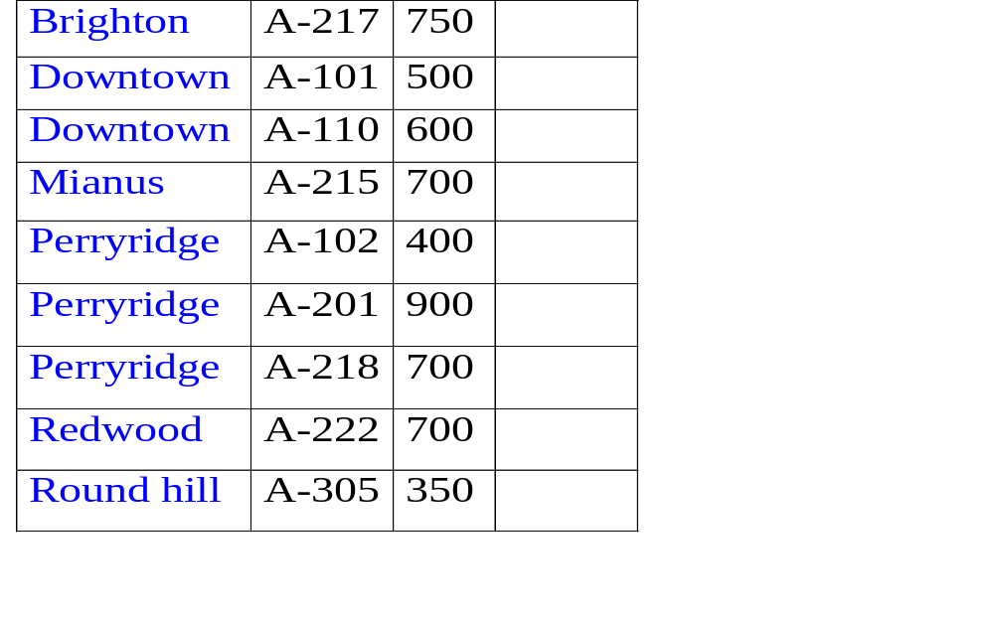
Sequential File Organization
Suitable for application that require sequential processing of the entire file
The records in the file are ordered by a search-key

Slide 9
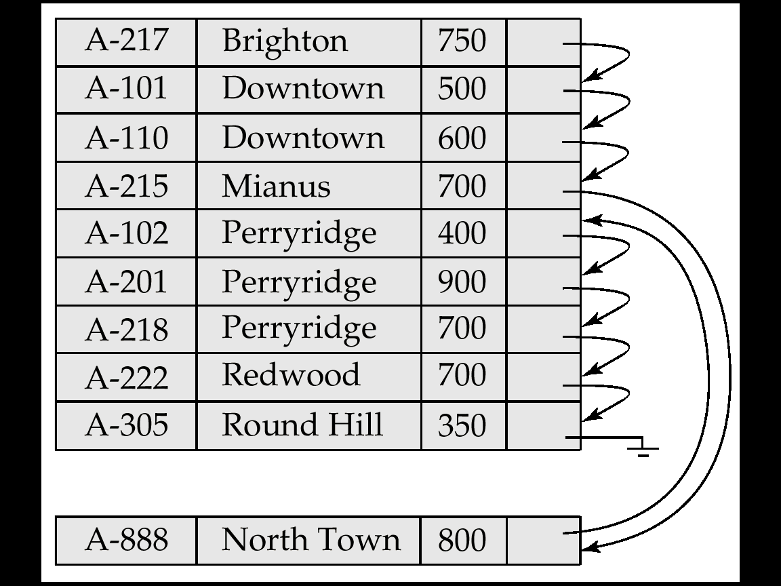
Sequential File Organization (cont.)
Deletion − use pointer chains
Insertion − must locate the position in the file where the record is to be recorded
  if there is free space insert there
  if no free space, insert the record in an overflow block
  In either case, pointer chain must be updated
Need to reorganize the file from time to time to restore sequential order

Slide 10
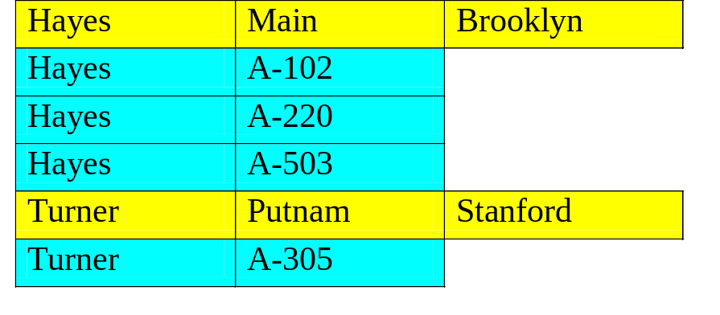
Clustering File Organization
Simple file structure stores each relation in a separate file
can instead store several relations in one file using a clustering file organization
E.g., clustering organization of customer and depositor.
customer
1 cluster
depositor
Good for queries involving depositor customer, and for queries involving one single customer and his accounts
Bad for queries involving only customer
Result in variable size records

Slide 11
Outline
Disks and Files
Indexes and Databases
Hash Files

Slide 12
Motivation
Many queries reference only a small proportion of the records in a file
  Eg., “find all instructors in the physics dept”
It is inefficient for the system to read every tuple to check if the dept_name is “physics”
Ideally, the system should be able to locate these records directly

Slide 13
Indexes and Databases
An index for a file in a database works in much the same way as the index in a book.
In a book, if we want to learn about a particular topic, we can search for the topic in the index, find the pages where it occurs, and then find the required information.

Slide 14
Indexes and Databases
Records are physically
stored in a hash table
based on a selected key
A table
(conceptual)
Index 1
(Ordered indices,
B-tree, hash)
Index 2
(Ordered indices,
B-tree, hash)

Slide 15

Basic Concepts
Indexing mechanisms speed up access to desired data
  E.g. If you know the call number of a book, you can go directly to the book shelve in the library; otherwise you have to search through all the book shelves
Search key − attributes used to look up records in a file.
An index file consists of records (called index entries) of the format:

Slide 16
Basic Concepts
Index files are typically much smaller than the original file
Two basic kinds of indices:
  Ordered indices: search keys are stored in sorted order
  Hash indices: search keys are distributed uniformly across “buckets” using a “hash function”.

Slide 17
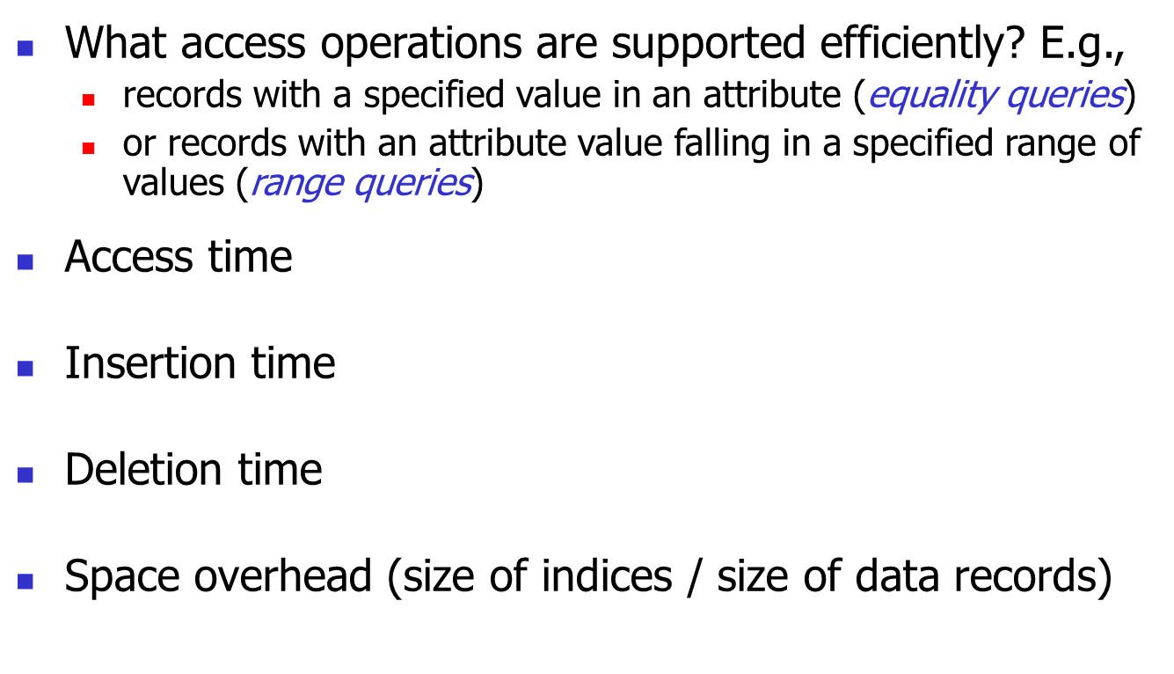
Index Evaluation Metrics

Slide 18
Ordered Indices
In an ordered index, index entries are stored based on the search key value. E.g., author catalog in library.
  Indices are mostly ordered indices except those based on hash files

Slide 19
Ordered Indices
Primary index: in a sequentially ordered file, the index whose search key specifies the sequential order of the file.
  Also called clustering index
  The search key of a primary index is usually but not necessarily the primary key.
Secondary index: an index whose search key specifies an order different from the sequential order of the file. Also called non-clustering index.

Slide 20
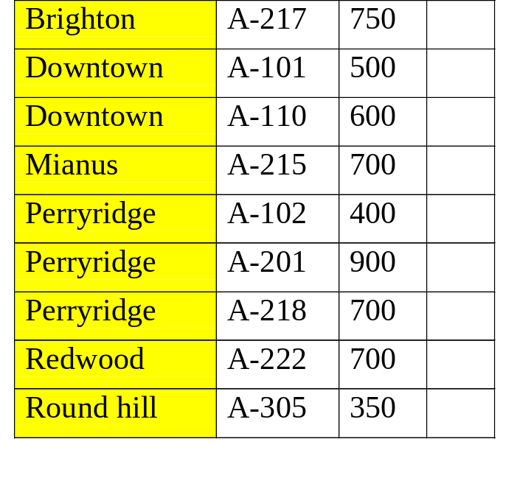
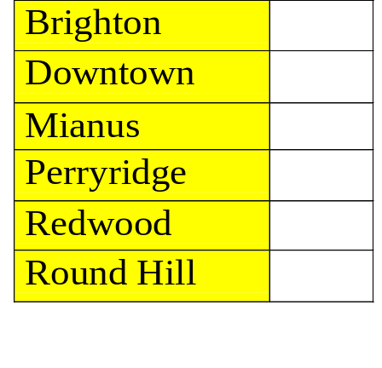
Index Structure Design: Dense Index Files
Every search-key value in the data file is indexed.
Dense index
Data records

Slide 21
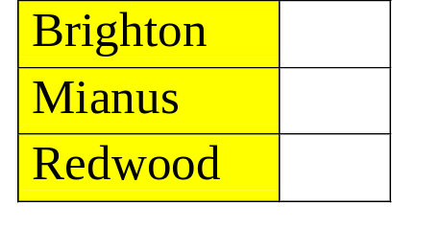
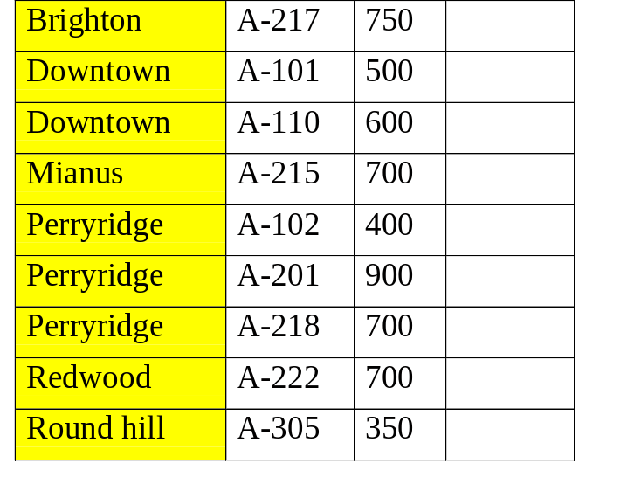
Sparse Index Files
Not all of the search-key values are indexed
  Adv: reduce index size Disadv: slower
Records in table are sorted by primary key values
Search is done in two steps: (i) find the largest possible key
(ii) search the record forward

Slide 22
Example of Sparse Index Files
To locate a record with search-key value K we:
  find index record with largest search-key value ≤ K
  search file sequentially starting at the record to which index record points
Less space and less maintenance overhead for insertion and deletions.
Generally slower than dense index for locating records.
Good Tradeoff: access time and space overhead

Slide 23
Multilevel Index
If an index file is small enough to be kept entirely in main memory, the search time to find an entry is low.
However, if the index is so large that not all of it can be kept in memory, index blocks must be fetched from disk when required. The search for an entry in the index then requires several disk-block reads.

Slide 24
Multilevel Index
To reduce number of disk accesses to index records, treat primary index kept on disk as a sequential file and construct a sparse index on it.
  Outer index − a sparse index of primary index
  Inner index − the primary index file
If even outer index is too large to fit in main memory, yet another level of index can be created, and so on (multi-level indices).

Slide 25
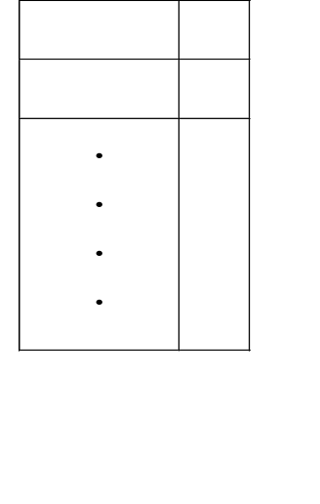
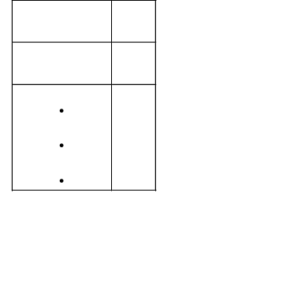
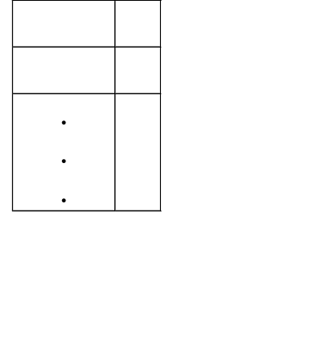
Multilevel Index (Cont.)
Data
block 0
Index
Block 0
Index
Block 1
Data
block 1
outer index
Data
block 2
Inner index
Data
block 3

Slide 26
Index Update
Regardless of what form of index is used, every index must be updated whenever a record is either inserted into or deleted from the file.
When a record in the file is updated, any index whose search-key attribute is affected by the update must be also updated.

Slide 27
Index Update: Deletion
If deleted record was the only record in the file with its particular search-key value, the search-key is deleted from the index also.
Single-level index deletion:
  Dense indices − similar to file record deletion

Slide 28
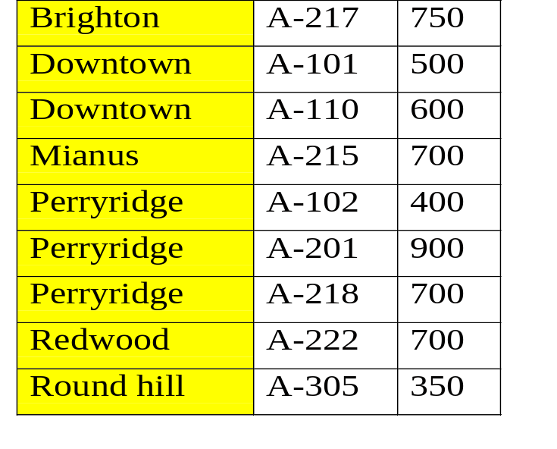
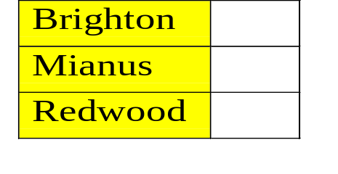
Index Update: Deletion in Sparse Indices
Sparse indices − if an entry for the search key exists in the index, it is deleted by replacing the entry in the index with the next search-key value in the file (in search-key order). If the next search-key value already has an index entry, the entry is deleted instead of being replaced.
Downtown

Slide 29
Index Update: Insertion
Single-level index insertion:
  Perform a lookup using the search-key value appearing in the record to be inserted.
  Dense indices - if the search-key value does not appear in the index, insert it.
  Sparse indices - if index stores an entry for each block of the file, no change needs to be made to the index unless a new block is created. In this case, the first search-key value appearing in the new block is inserted into the index.
Multilevel insertion (as well as deletion) algorithms are simple extensions of the single-level algorithms.

Slide 30
Secondary Indices
You can organize a file (say, into indexed sequential file) based on one attribute only (e.g., emp#), but it is not adequate in practice
Frequently, one wants to find all the records whose values in a certain field (which is not the search-key of the primary index) satisfy some conditions.
  Example 1: if the account database stored sequentially by account number, we may want to find all accounts in a particular branch.
  Example 2: as above, but where we want to find all accounts with a specified balance or range of balances.
We can have a secondary index with an index record for each search-key value: an index record points to a bucket that contains pointers to all the actual records with that particular search-key value.

Slide 31
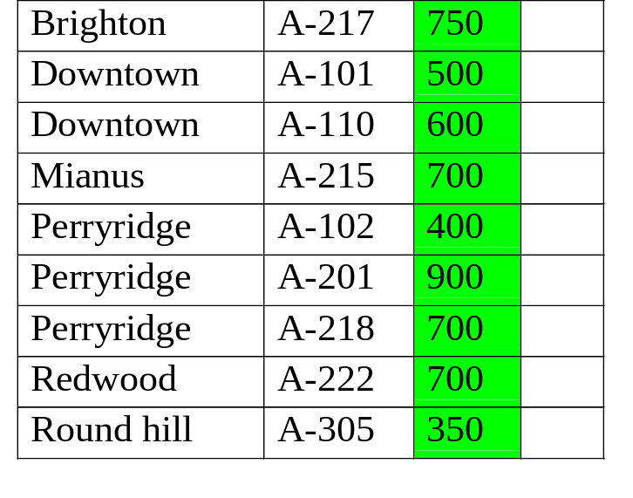
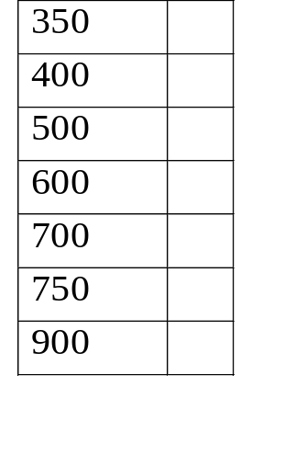
Secondary Index on Balance Field of Account
Secondary Index
Note: the file is already indexed based
on branch-name

Slide 32
Primary and Secondary Indices
Secondary indices have to be dense because records are not sorted by the secondary index values
Indices offer substantial benefits when searching for records, always select some attributes to index and re-examine the selection periodically
When a file is modified, every index on the file must be updated. Updating indices imposes overhead on database modification
Sequential scan using primary index is efficient, but a sequential scan using a secondary index is expensive (each record access may fetch a new block from disk.)

Slide 33
Outline
Disks and Files
Indexes and Databases
Hash Files

Slide 34
Hash Files
In previous data structure course, you may learn hash table, which is main-memory resident
A hash method includes a hash function and a collision handling mechanism
In main memory, the unit of access is based on byte or word sizes
In disk-based hash file, the unit of access is based on disk block size (from 512 to 2048 bytes, depending on OS)

Slide 35
Hash Files
Static Hashing
Dynamic Hashing

Slide 36
Static External Hashing
A hash file consists of M buckets of the same size: bucket₀, bucket₁,... bucket_{M-l}
Bucket 0
i = h(K)
Record to be
inserted with
key K
Hash
function
h()
Bucket i
Overflow
bucket
Collisions occur when a new record hashes to a bucket that is already full. A new bucket is created and chained to the overflowed bucket
  To reduce overflow records, a hash file is typically kept 70-80% full

Slide 37
Static External Hashing – Properties
The hash function h() should distribute the records uniformly among the buckets; otherwise, search time will increase due to many overflow records
  An ideal hash function will assign roughly the same number of records to each bucket irrespective of the actual distribution of search-key values in the file
The number of buckets M must be fixed when the file is created; not good when the file size changes widely
  As a design criteria, you need to determine the load factor

Slide 38
Static External Hashing – Example
Hash file organization of account file, using branch-name as key.
An example of a hash function defined on a set of charaters in a file organization:
  There are 10 buckets
  Take the ASCII code of each character as an integer
  Sum up the binary representations of the characters and then applies modulo 10 to the sum to get the bucket number

Slide 39
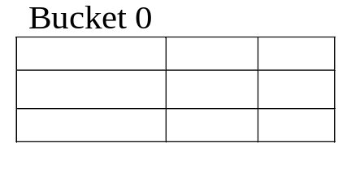
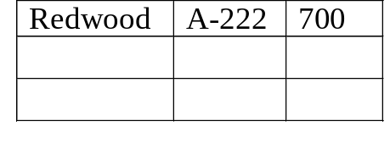
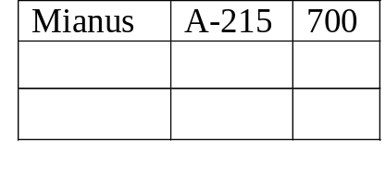
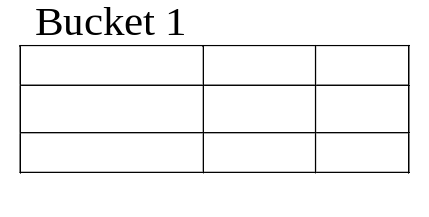
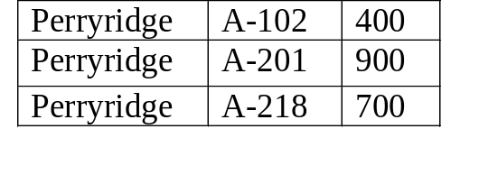
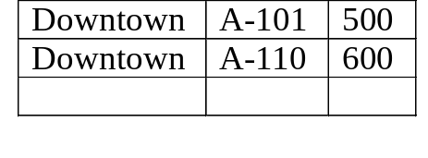
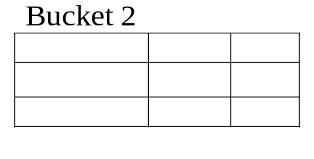

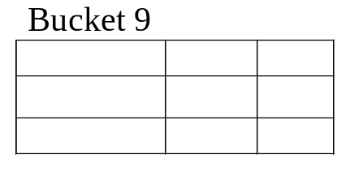
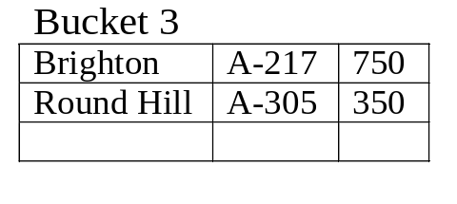
Example of hash File Organization
Bucket 4
Bucket 7
Bucket 5
Bucket 8

Slide 40
Hash Indices
Hashing can be used not only for file organization, but also for index-structure creation. A hash index organizes the search keys, with their associated record pointers, into a hash file structure.
Hash indices are always secondary indices
hash index
(e.g., on salary)
data file (e.g., hash or index sequential on emp#)

Slide 41
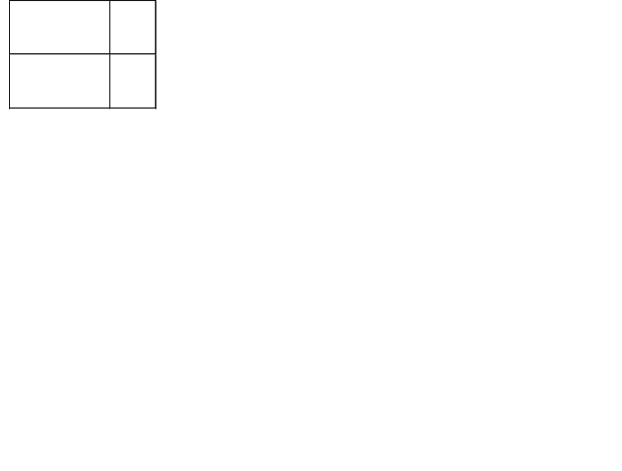
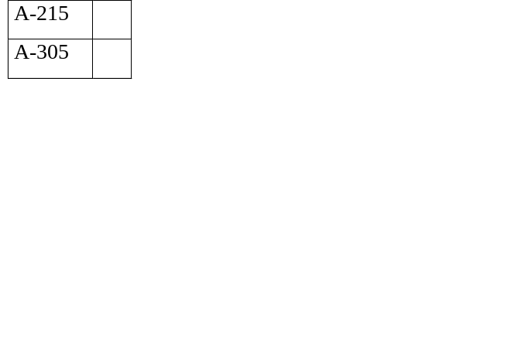
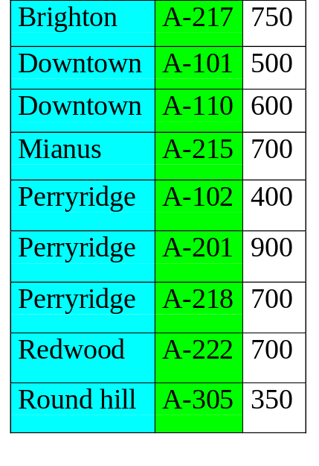
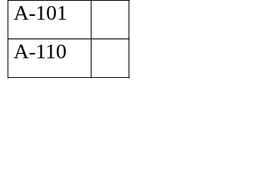


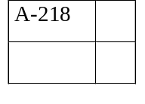
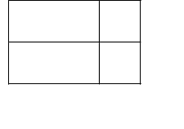
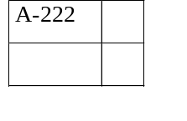
Example of hash Index
Used as a
secondary
index
Bucket 0
Primary index
Bucket 1
Bucket 2
Bucket 3
Bucket 4
Overflow
bucket
Bucket 5
Bucket 6
Hash Index on account-number

Slide 42
Hash Files
Static Hashing
Dynamic Hashing

Slide 43
Dynamic Hashing
Good for database that grows and shrinks in size
Allows the hash function to be modified dynamically
  When the hash function takes modulo 10 in the previous example, the number of buckets is fixed to 10
  The trick is how to change the hash function so that the number of buckets can change
  And at the same time, without the need of rehashing the existing records!
  Imagine if you change modulo 10 to modulo 13, then every existing record has to be rehashed – not a good idea

Slide 44
Extendable Hashing
Extendable hashing - one form of dynamic hashing
  Hashing function generates values over a large range - typically
  b-bit integers, with b = 32.
b-1
0
i bits
At any time, use only a prefix of the b-bit integers to index into a table of bucket addresses. Let the length of the prefix be i bits, 0<=i<=32
If i = 1, meaning that it can index at most 2 buckets
When the 2 buckets are full, we can use 2 bits (i = 2), meaning that we can now index at most 4 buckets, and so on and so forth….
i grows and shrinks as the size of the database grows and shrinks.
Actual number of buckets is <=2^{i}, which may change due to bucket merging and splitting

Slide 45
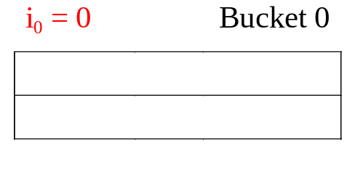
Extendable Hash Structure − General Ideas
hash
prefix
i = 0
New record
0
hash table
Initially, i = 0, use 0 bit in the hash key, resulting in two entries in the hash address table
Suppose we start with only 1 or 2 records, we need only 1 bucket initially
Both entries in the hash address table point to the same bucket
i₀ = 0 means no bit had been used to separate records in the bucket (I.e., records are all hashed into bucket 0 irrespective of the any bit setting in the hash key values)

Slide 46
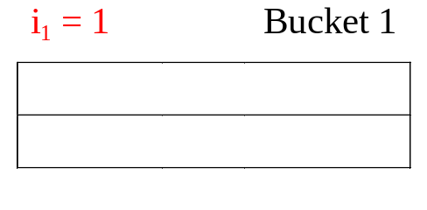
Extendable Hash Structure − Bucket Expansion
hash
prefix
i = 0
0
hash table
New record
Suppose bucket 0 is full and a new record arrives
Create a new bucket, rehash the three records (two existing ones and the new record) into buckets 0 and 1

Slide 47
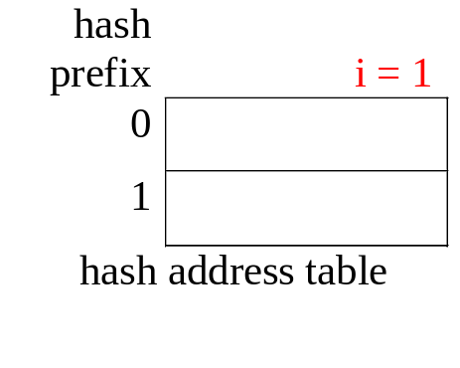
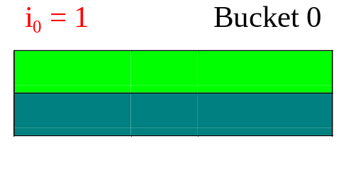
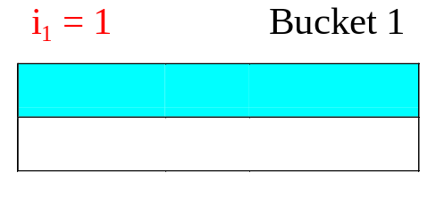
General Extendable Hash Structure
New record
Record originally
in bucket 0
Note: why do we need to keep i, i₀ and i₁?
i is the maximum number of bits used in hashing so far; i₀ and i₁ are the number of bits used for these particular buckets

Slide 48
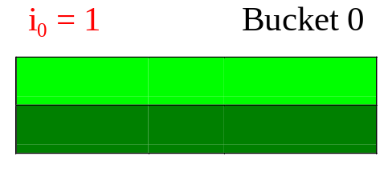
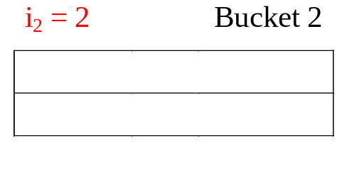
General Extendable Hash Structure
A new record
1) Upon inserting of a new (red) record, bucket 0 is full again
2) Bucket 2 is created, and the three records (two existing ones and the new one) are rehashed among buckets 0 and 2 based on the second bit

Slide 49
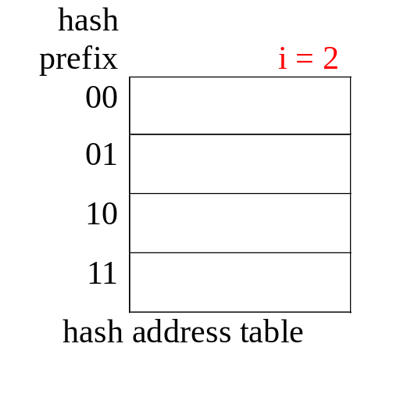
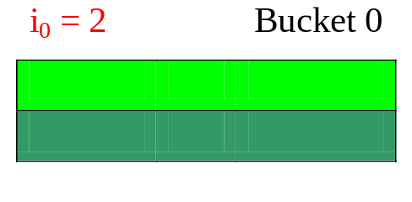
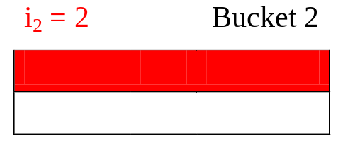
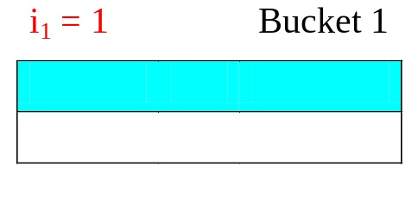
General Extendable Hash structure
2 bits from the hash key had been used to hash the records
use the 3rd bit in next split
use the first 2 bits from the hash key to address the 4 entries in the table.
Bucket 2 is new
Bucket 1 not
changed
1 bit from the hash key had been used to hash the records
use the 2nd bit in next split

Slide 50
Extendable Hash Structure – Properties
Every expansion doubles the number of entries in the table
Multiple entries in the bucket address table may point to the same bucket. It means that the bucket hasn’t been expanded while other buckets had been expanded multiple times
Each bucket j stores a value i_{j}; entries in the same bucket have the same values on the first i_{j} bits of the hash keys

Slide 51
To locate the bucket containing search-key K_{j}:
1. Compute h(K_{j}) = X
2. Use the first i high order bits of X to look up the hash address table, and follow the pointer to appropriate bucket

Slide 52
To insert a record with search-key value K_{j},
  look up the bucket where it should belong, say j.
    If there is room in bucket j
      insert record in the bucket,
    else
      the bucket must be split and insertion re-attempted.

Slide 53
Split in Extendable hash Structure
To split a bucket j when inserting record with search-key value K_{j};
If i > i_{j} (more than one pointer to bucket j)
  allocate a new bucket z, and set i_{j} and i_{z} to the old i_{j}+1.
  make the second half of the bucket address table entries pointing to j to point to z
  remove and reinsert each record in bucket j.
  recompute new bucket for K_{j} and insert record in the bucket (further splitting is required if the bucket is still full)
could be any number > 1
1
2
2
2

Slide 54
Split in Extendable hash Structure
To split a bucket j when inserting record with search-key value K_{j};
If i = i_{j} (only one pointer to bucket j)
  increment i and double the size of the bucket address table.
  Replace each entry in the table by two entries that point to the same bucket.
  Re-compute new bucket address table entry for K_{j}, now i > i_{j}, so use the first case above.
i₀=2
i₁=2
new record
i₂=2
i₃=2

Slide 55
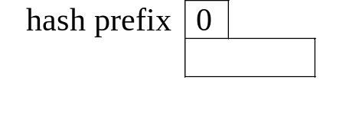
Example: Use of Extendable Hash Structure
Branch-name h(branch-name)
Brighton 0010 1101 1111 1011 0010 1100 0011 0000
Downtown 1010 0011 1010 0000 1100 0110 1001 1111
Mianus 1100 0111 1110 1101 1011 1111 0011 1010
Perryridge 1111 0001 0010 0100 1001 0011 0110 1101
Redwood 0011 0101 1010 0110 1100 1001 1110 1011
Round hill 1101 1000 0011 1111 1001 1100 0000 0001
Initial Hash structure, Bucket size=2
0
Bucket 0
hash address table

Slide 56
Insert:
Brighton, A-217, 750
0010 1101 1111 1011 0010 1100 0011 0000
no bit is needed from the hash value (i=0)
0
Brighton, A-217, 750

Slide 57
Insert:
Downtown, A-101, 500
1010 0011 1010 0000 1100 0110 1001 1111
no bit is needed from the hash value (i=0)
0
Brighton, A-217, 750
Downtown, A-101, 500
Insert:
bucket full, split records according to first bit (i=1)
Downtown, A-101, 600

Slide 58
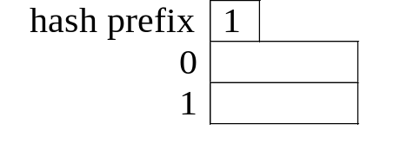
Brighton 0010 1101 1111 1011 0010 1100 0011 0000
Downtown 1010 0011 1010 0000 1100 0110 1001 1111
1
Brighton, A-217, 750
1
Downtown, A-101, 500
Downtown, A-101, 600
Insert:
Mianus, A-215, 700
1100 0111 1110 1101 1011 1111 0011 1010
Hash into bucket 1, which is full

Slide 59
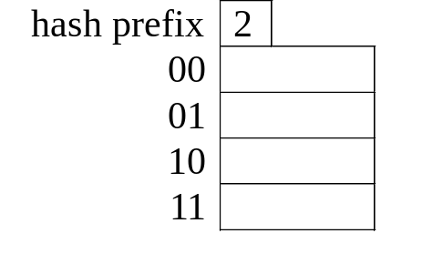
Mianus 1100 0111 1110 1101 1011 1111 0011 1010
Downtown 1010 0011 1010 0000 1100 0110 1001 1111
1 bit had been used
to allocate records
1
Brighton, A-217, 750
2
2 bits had been used
to allocate records
Downtown, A-101, 500
Downtown, A-101, 600
2
Note: directory size is doubled
Mianus, A-215, 700

Slide 60
1
Brighton, A-217, 750
2
Downtown, A-101, 500
Downtown, A-101, 600
2
Mianus, A-215, 700
Perryridge, A-102, 400
Insert:
Perryridge, A-102, 400
1111 0001 0010 0100 1001 0011 0110 1101
Insert:
Perryridge, A-201, 900
Bucket 2 overflows
again!
1111 0001 0010 0100 1001 0011 0110 1101

Slide 61
1
Brighton, A-217, 750
0
0
0
0
1
1
1
1
2
Downtown, A-101, 500
00
01
10
11
Downtown, A-101, 600
2
3
Mianus, A-215, 700
Perryridge, A-102, 400
3
Perryridge, A-201, 900
Expand hash address table, renumber the entries by adding one more bit to the left
Bucket 10 becomes bucket 10x, where x could be 0 or 1
Bucket 11 becomes bucket 110 and 111, because it is split; new bucket is added; local level is updated
Redistribute overflow and
new record

Slide 62
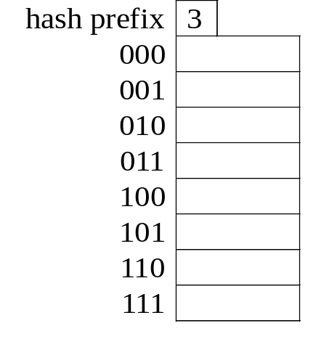
1
Brighton, A-217, 750
2
Downtown, A-101, 500
Downtown, A-101, 600
3
Mianus, A-215, 700
3
Perryridge, A-201, 900
Perryridge, A-102, 400
Perryridge, A-218, 700
Insert:
Perryridge, A-218, 700
Bucket 3 overflows
again!
1111 0001 0010 0100 1001 0011 0110 1101

Slide 63
1
Brighton, A-217, 750
Redwood, A-222, 700
2
Downtown, A-101, 500
Downtown, A-101, 600
3
Mianus, A-215, 700
Round Hill, A-305, 350
3
Perryridge, A-201, 900
Perryridge, A-102, 400
Perryridge, A-218, 700
Done!

